Slide 1

Unicorn Companies Data Analytics
Insights into the Growing Unicorn Ecosystem
By /
Elsayed Ibrahim Elsayed
Notes:
Unicorn companies are defined as startups that reach a valuation of $1 billion and are not listed on the stock market.

Slide 2
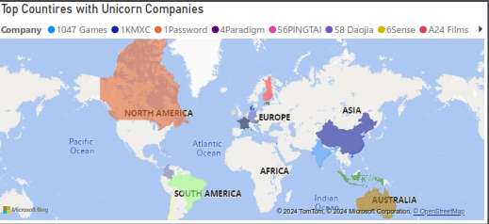
Global Unicorn Distribution
Notes:
United States dominance
Emerging markets like China and India catching up

Slide 3


Slide 4
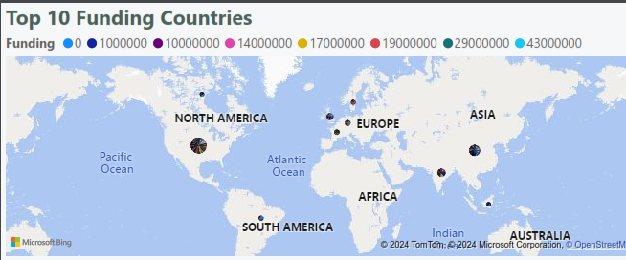
Global Unicorn Distribution
Notes:
United States dominance
Emerging markets like China and India catching up

Slide 5
Global Unicorn Distribution
Notes:
The US leads significantly in the number of unicorns, followed by China and India.

Slide 6
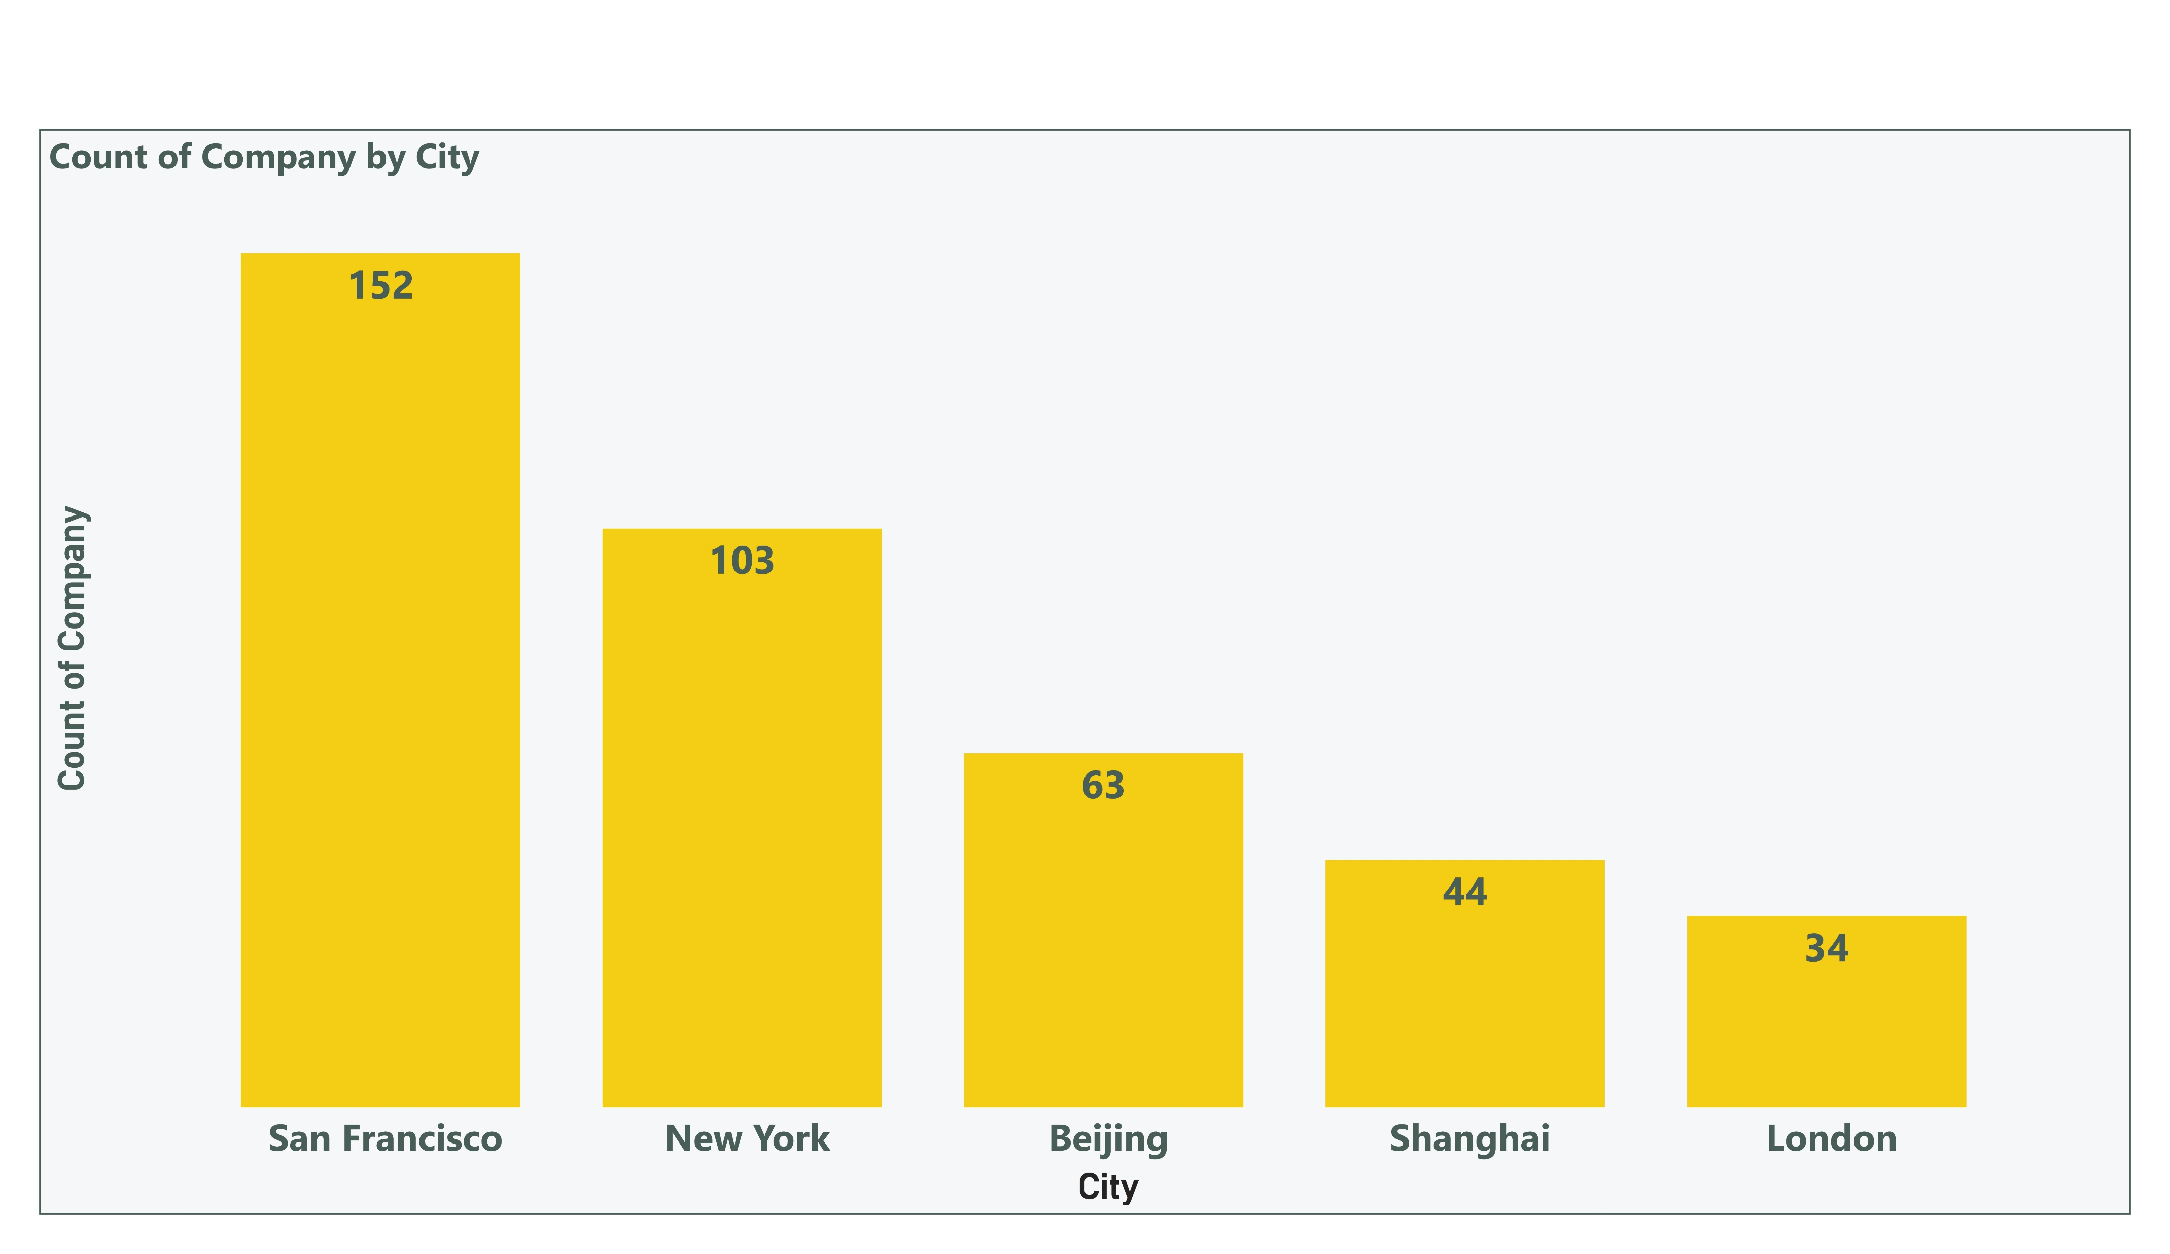
Cities with the Most Unicorns
Notes:
San Francisco and New York are major unicorn hubs.
San Francisco and New York are the top cities, indicating their role as major hubs for innovation and venture capital.
Other notable cities include Beijing, Shanghai, and London.

Slide 7
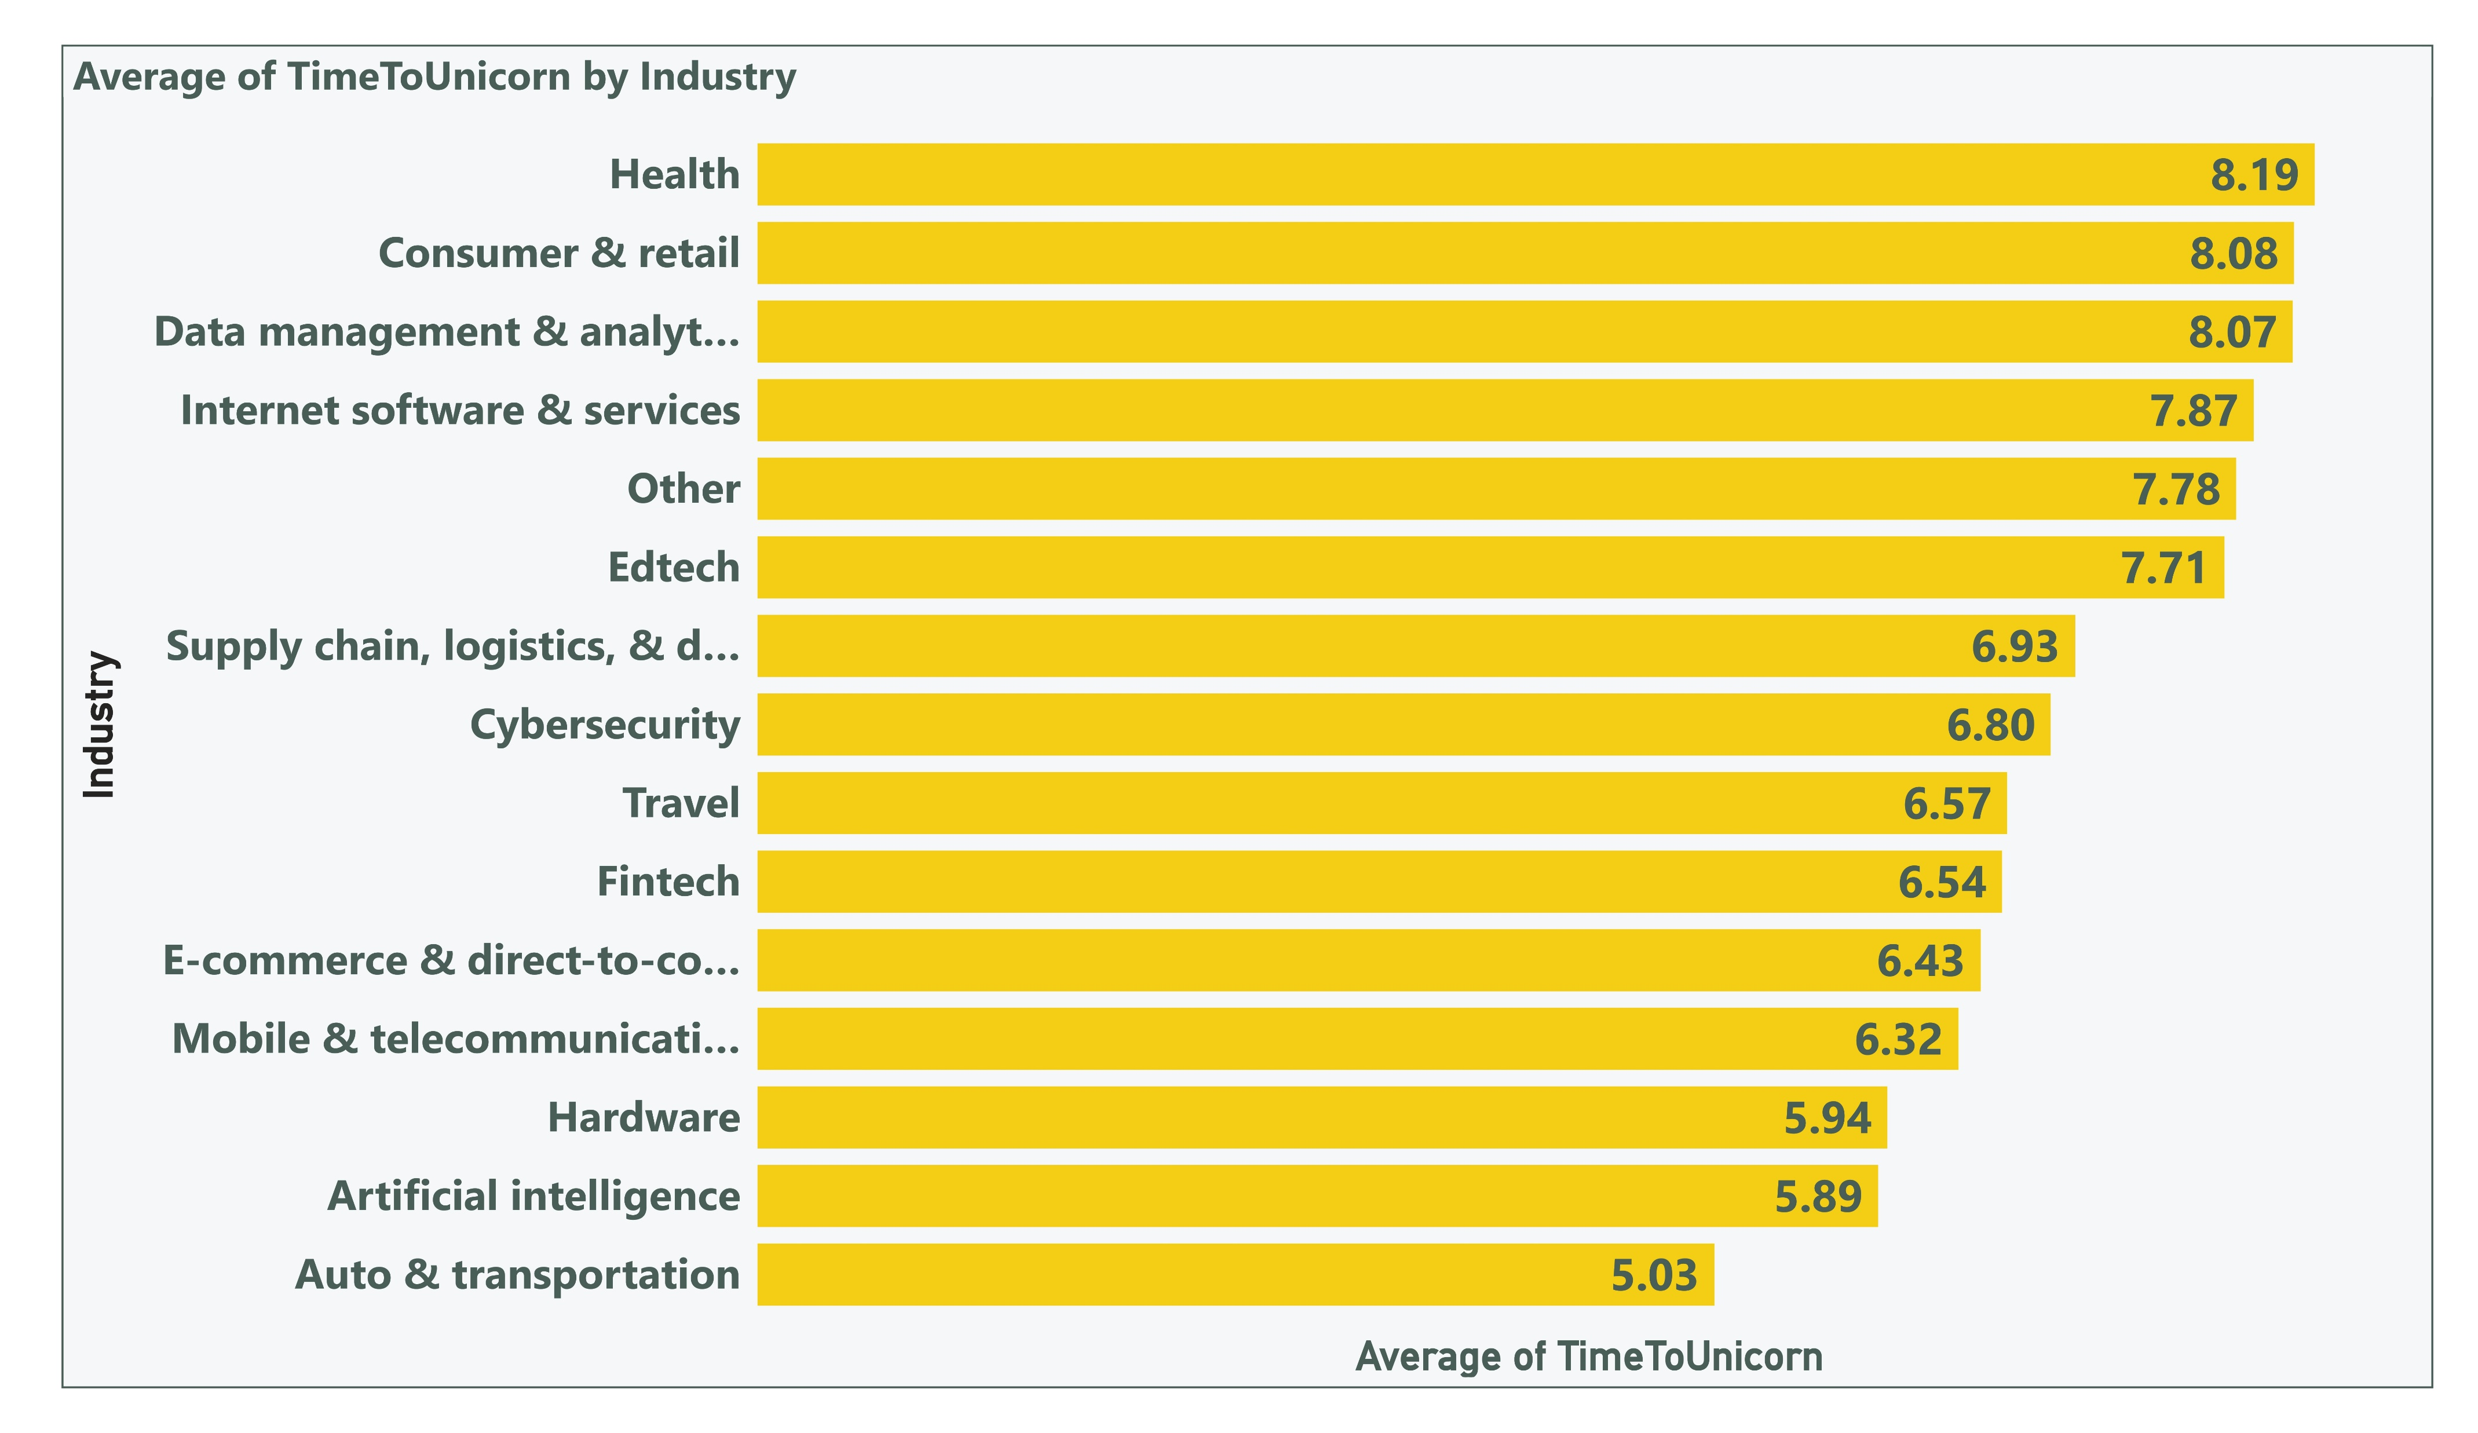
Time to Unicorn Status by Industry
Notes:
The data suggests that traditional and highly regulated industries tend to take longer to achieve unicorn status, while tech-driven and emerging sectors reach this milestone faster due to rapid innovation cycles, easier scalability, and higher investor interest.

Slide 8
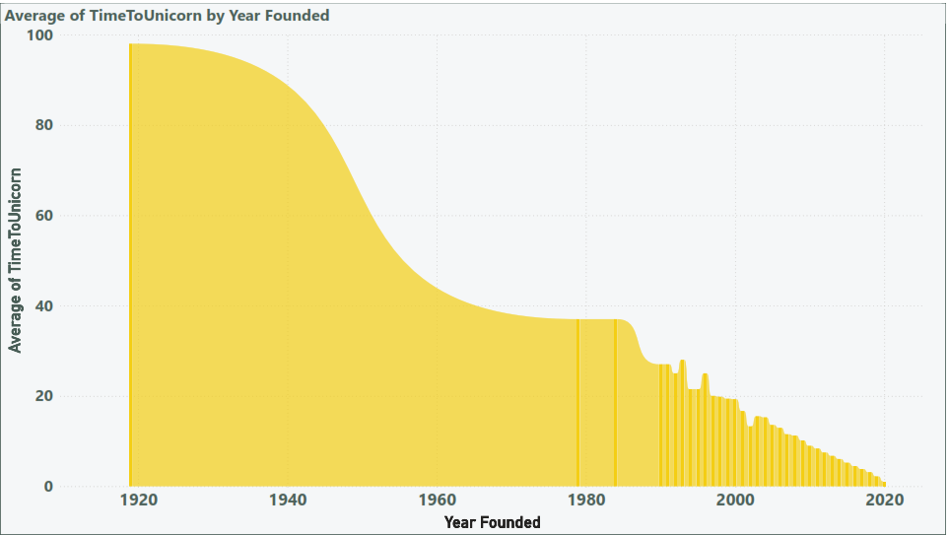
Average Time to Reach Unicorn Status
Notes:
The time to achieve unicorn status has decreased in recent years.
Decreasing time to unicorn status
Importance of early-stage investment

Slide 9
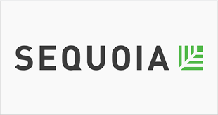

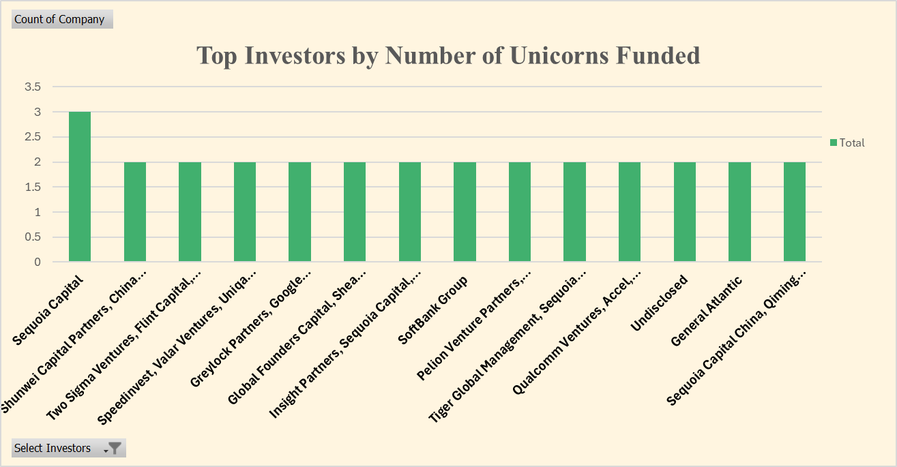
Top Investors by Number of Unicorns Funded
Notes:
Sequoia Capital and Tiger Global Management are leading investors
Sequoia Capital's leading role
Value of partnering with established investors

Slide 10
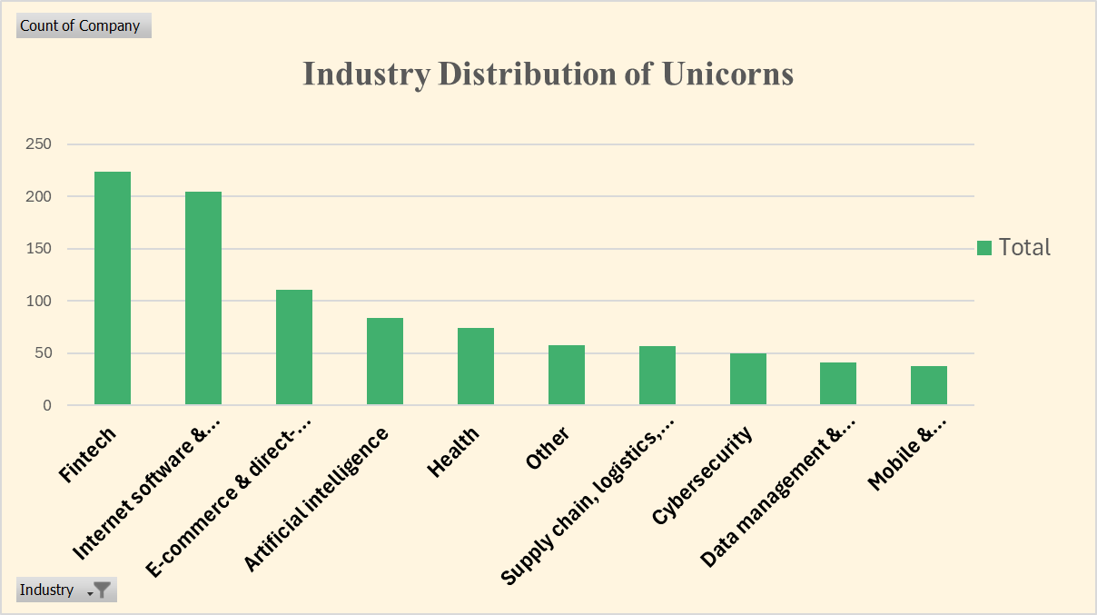
Industry Distribution of Unicorns
Notes:
Fintech and Internet Software & Services dominate the unicorn landscape.
Fintech's dominance
Growth potential in other industries like AI and healthcare

Slide 11
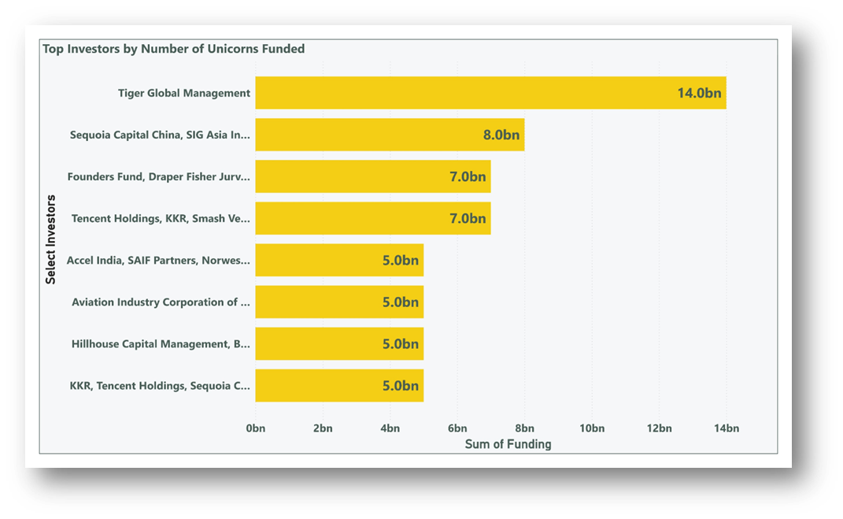
Top Investors by Number of Unicorns Funded
Notes:
Sequoia Capital, Tiger Global Management, and Andreessen Horowitz are among the top investors, showcasing their significant role in identifying and funding high-potential startups.
The presence of multiple top investors highlights the competitive nature of venture capital in the unicorn space.

Slide 12
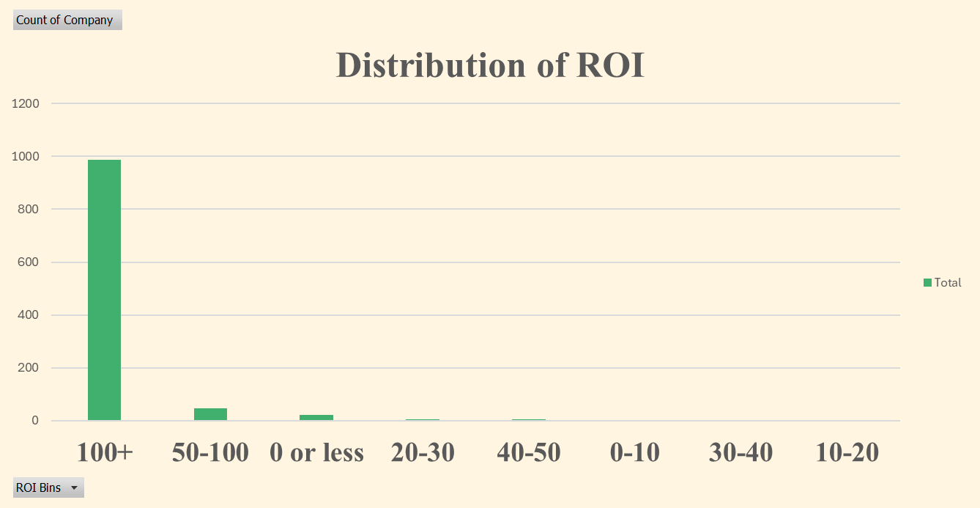
Distribution of ROI
Notes:
Most unicorns have an ROI of over 100%.
Most unicorns have an ROI of over 100%, reflecting the high return potential of these companies.
A small percentage of unicorns have lower ROI, highlighting the varying success levels within the unicorn cohort.

Slide 13
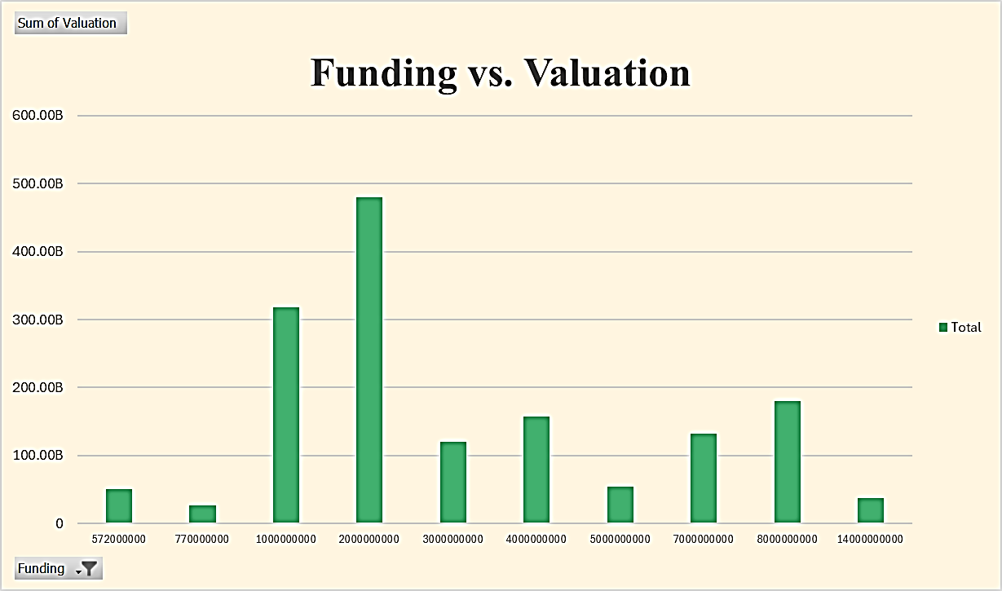
Funding vs. Valuation
Notes:
Higher funding rounds generally correlate with higher valuations.
Strong correlation between funding and valuation
Illustrates the importance of attracting significant funding.

Slide 14
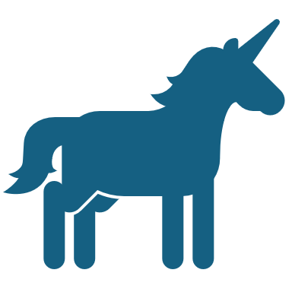
Conclusion
The unicorn landscape is dynamic and constantly evolving.
The United States continues to dominate the unicorn scene, with a significant number of unicorns, followed by China. San Francisco and New York City are leading hubs for unicorn companies.
The average time to reach unicorn status has shown a steady decline over the years, suggesting a faster pace of growth for startups.
Fintech and internet software industries are the dominant sectors for unicorns.
Notably, there is a strong correlation between funding and valuation, indicating the importance of securing substantial capital for achieving unicorn status.

Slide 15
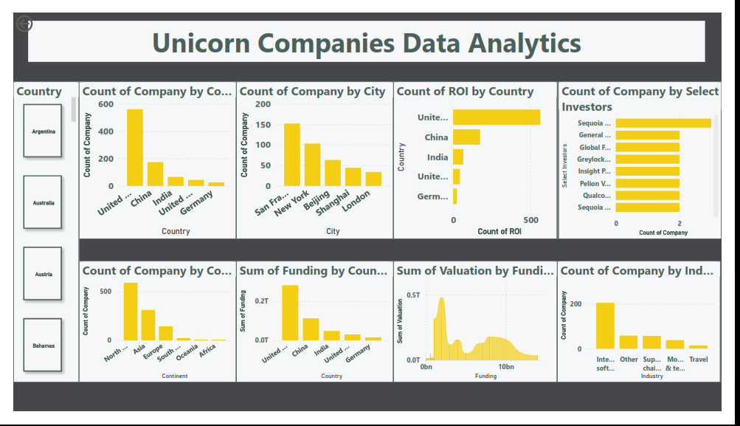
Dashboards by Power Bi

Slide 16
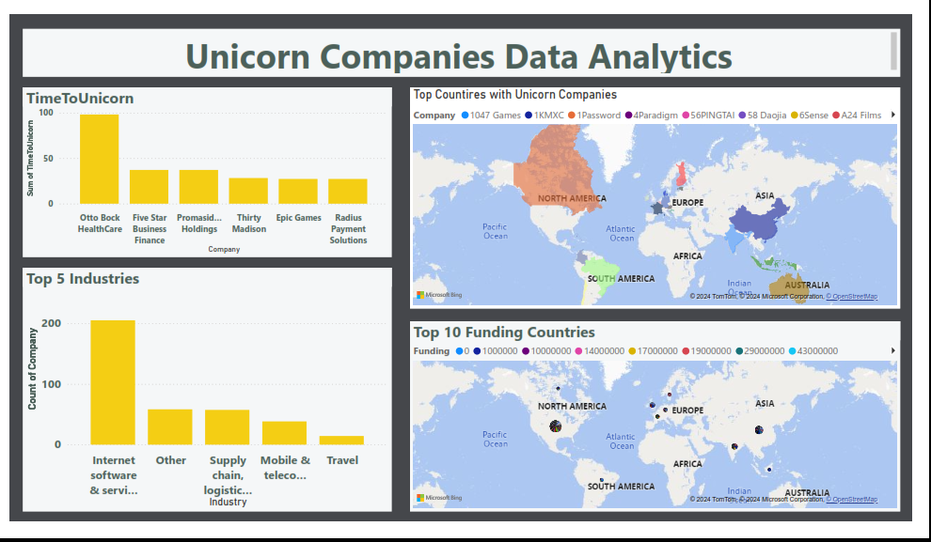
Dashboards by Power Bi

Slide 17
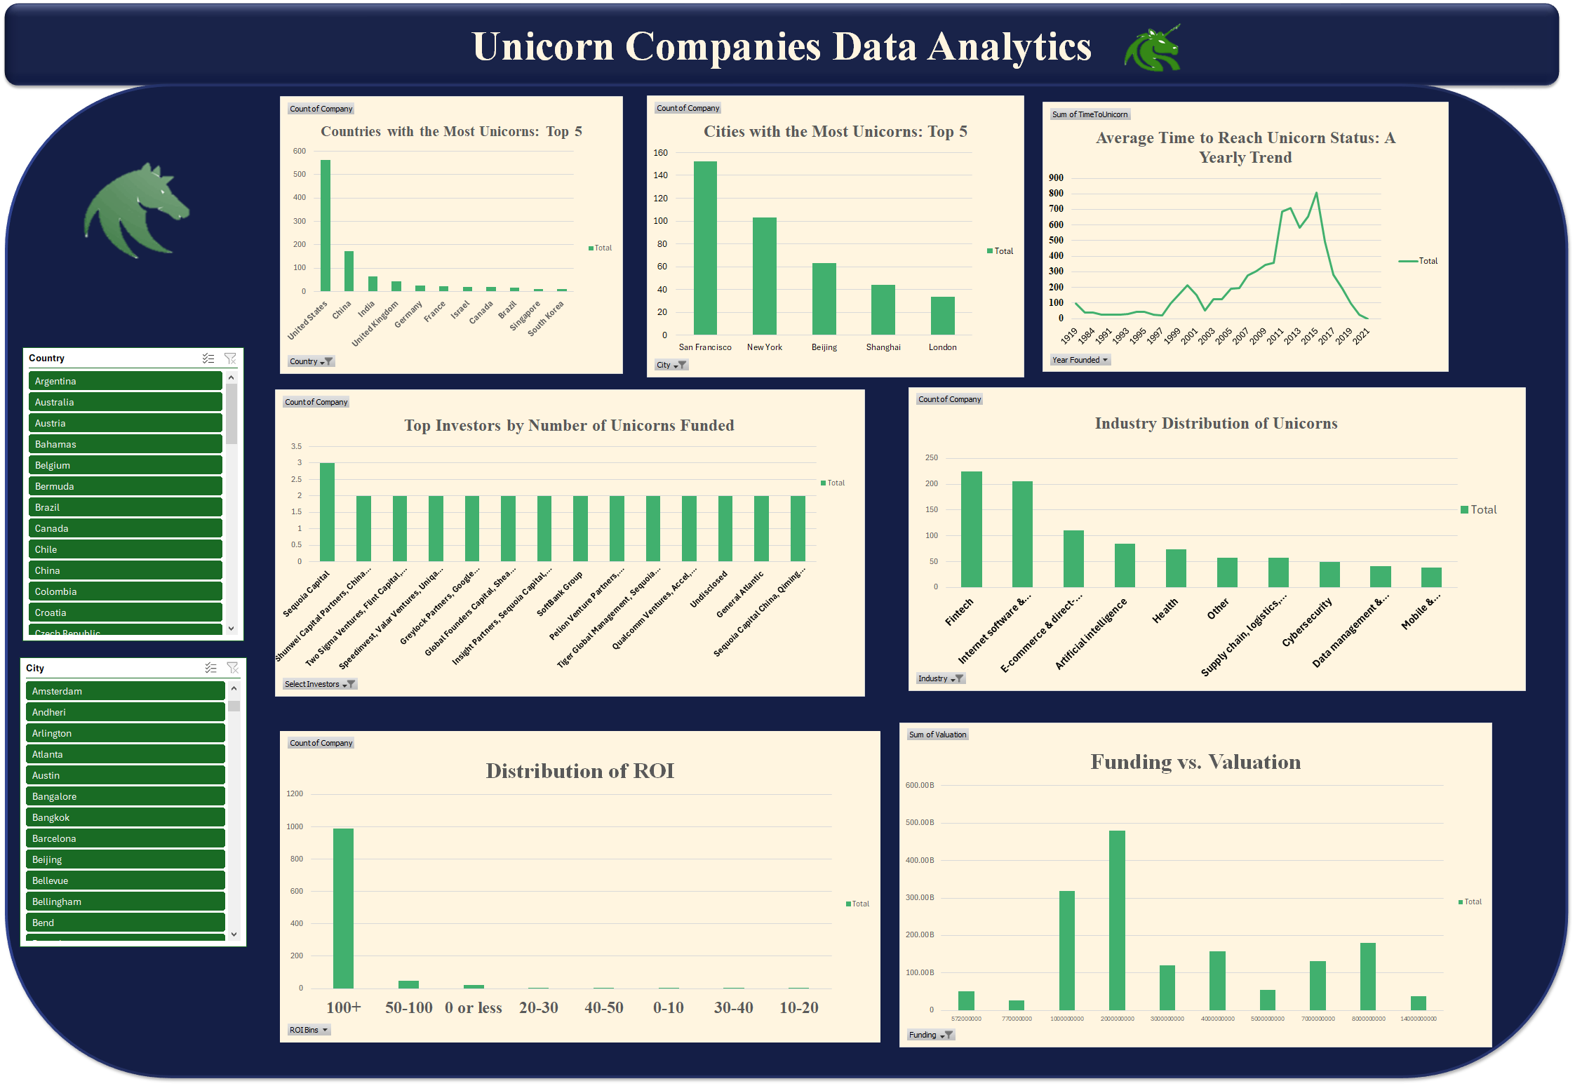
Dashboards by Excel

Slide 18

Q&A

